Slide 1
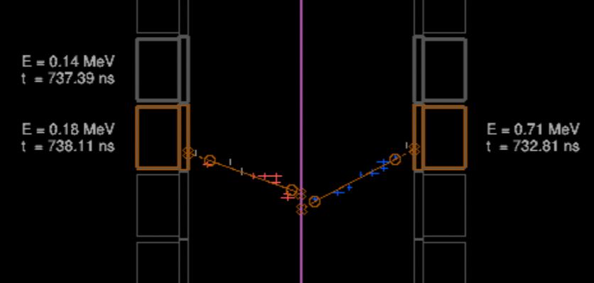
Extra calorimeter hit coincident in time

Slide 2
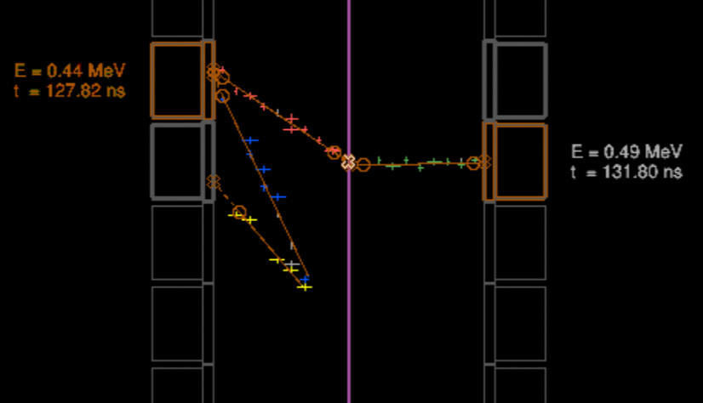
Multiple track associated to same OM

Slide 3
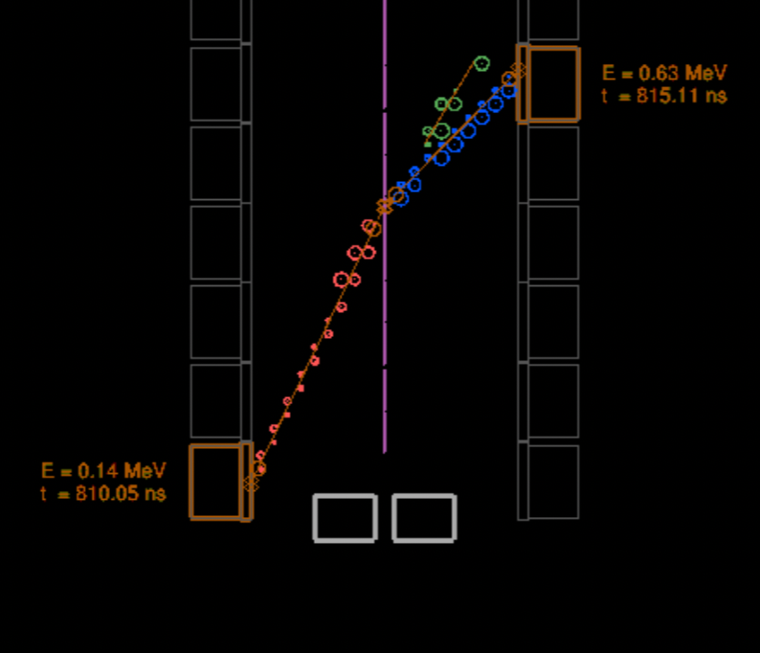
Extra track coincident in time

Slide 4
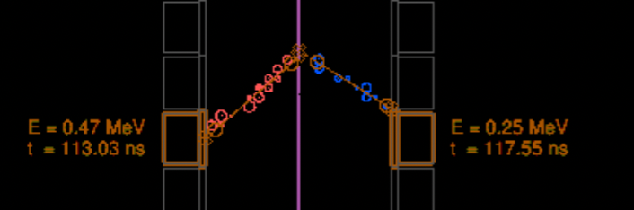
Good candidate no extra hits or tracks

Slide 5
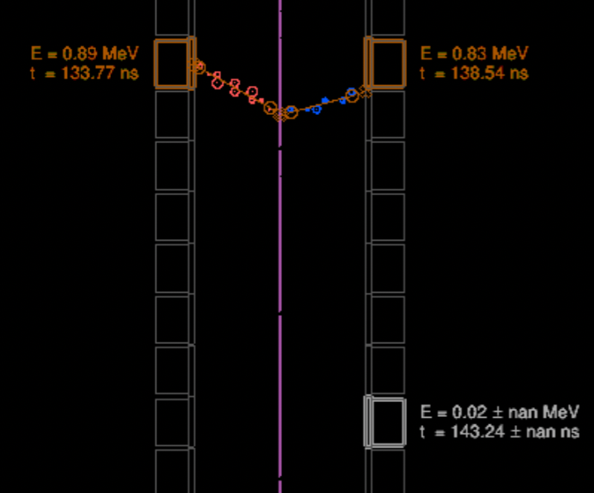
Good candidate, extra OM < 50keV

Slide 6
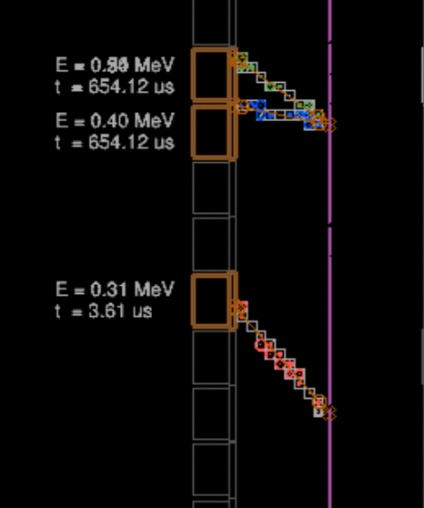
Good candidate, extra track not coincident in time

